Slide 1
Hand Detection from Video and Images using OpenCV
By:
Trishala A. Jadhav 2017BTECS00091
Sakshi G. Mhaiske 2017BTECS00097
Shrutika V. Vanga 2018BTECS00218

Slide 2
Problem Statement
The hand gestures are to be recognized to build an application.
Given images of hand gestures, implement suitable segmentation algorithm to detect hand.

Slide 3
Objectives
To make an application which is capable of -
Recognizing hands in a video or an image and
Counting the number of lifted fingers.

Slide 4
Methodology
Find the ROI (region of interest) from the image
Hand Segmentation : Convert the video frame or image from BGR to HSV(or Gray)
Perform a Threshold operation for hand segmentation based on skin color
Perform Dilation and Gaussian blur operation to remove the noise
Find the Biggest Contour (this will be our hand)
Perform a Convex Hull around the hand contour
Count the no. of convexity defects
Display it as number of fingers.

Slide 5
Segmentation of Hand Skin
For our convenience we have taken the values as
Lower skin color [0,20,70]
Upper skin color [20,255,255]

Slide 6
Convex Hull
In order to detect fingertips Convex Hull technique is used
Convex Set : set of points such that, if we trace a straight line from any pair of points in the set, that line must be also be inside the region
Convex Hull : smallest convex set that contains a set of points.
The result of convex hull is a smooth region, much easier to be analysed than the original hand contour which contains many imperfections.
Notes:
Contours can be explained simply as a curve joining all the continuous points (along the boundary), having same color or intensity.

Slide 7
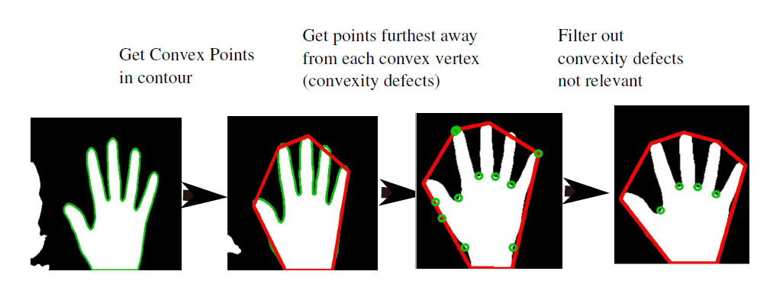
Convex Hull

Slide 8
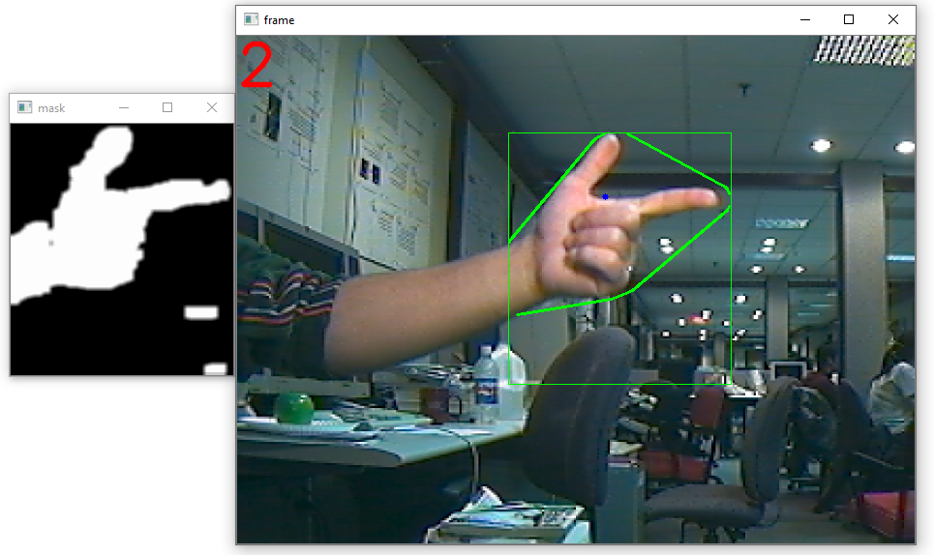
Results

Slide 9
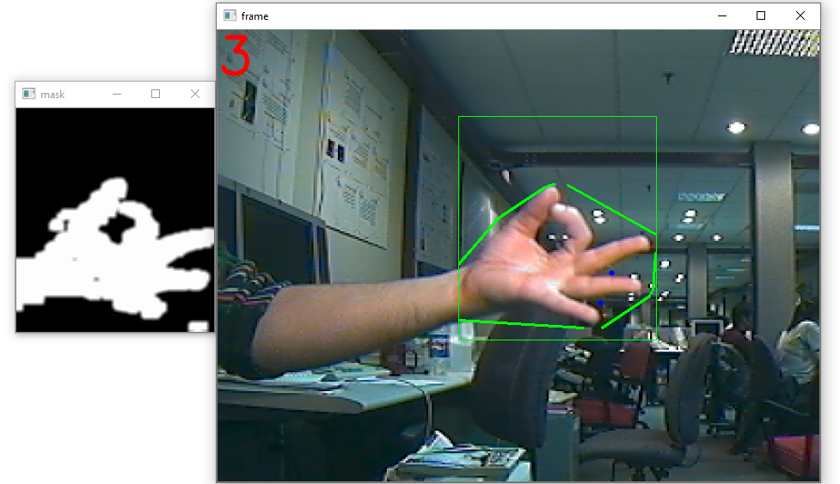
Results

Slide 10
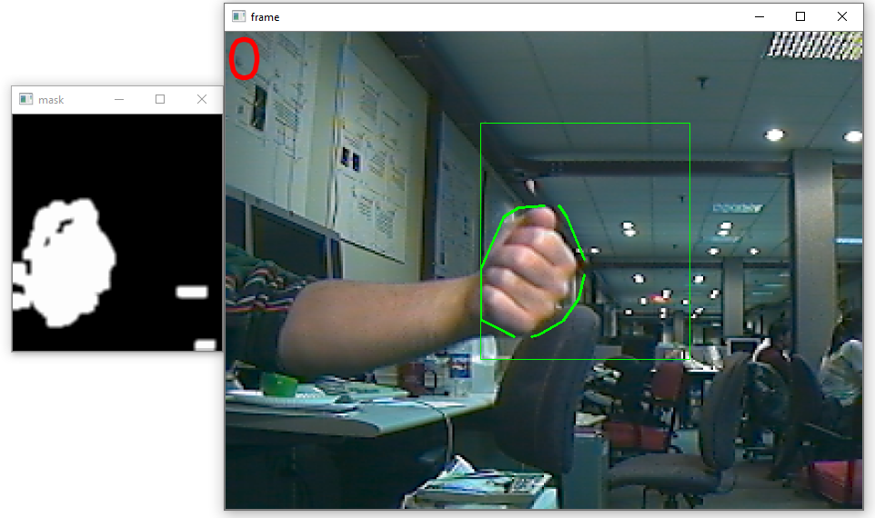
Results

